Slide 1

Git for Version Control
Sakil Mallick
Roll – 001510501050
B. CSE - IV

Slide 2



About Git
Created by Linus Torvalds, creator of Linux, in 2005
Came out of Linux development community
Designed to do version control on Linux kernel
Goals of Git:
Speed
Support for non-linear development (thousands of parallel branches)
Fully distributed
Able to handle large projects efficiently
(A "git" is a cranky old man. Linus meant himself.)

Slide 3

Centralized VCS
In Subversion, CVS, Perforce, etc. A central server repository (repo) holds the "official copy" of the code
the server maintains the sole version history of the repo
We make "checkouts" of it to our local copy
we make local modifications
our changes are not versioned
When we're done, we "check in" back to the server
our check-in increments the repo's version

Slide 4
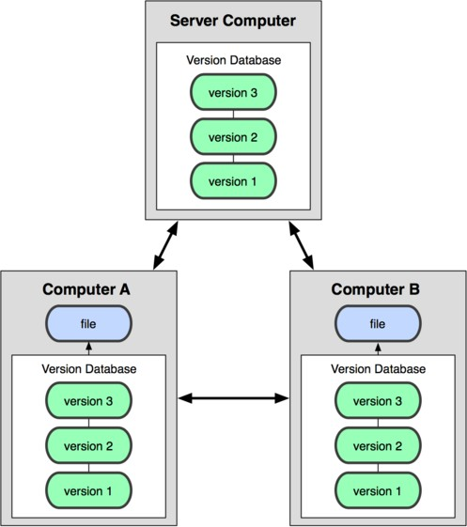
Distributed VCS (Git)
In git, mercurial, etc., we don't "checkout" from a central repo
we "clone" it and "pull" changes from it
Our local repo is a complete copy of everything on the remote server
ours is "just as good" as theirs
Many operations are local:
check in/out from local repo
commit changes to local repo
local repo keeps version history
When we're ready, we can "push" changes back to server

Slide 5
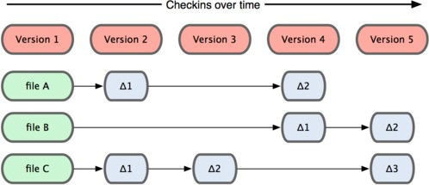
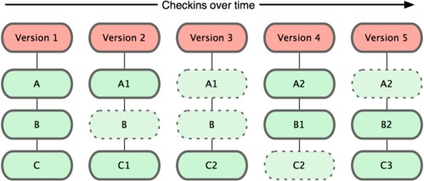
Git snapshots
Centralized VCS like Subversion track version data on each individual file.
Subversion
Git keeps "snapshots" of the entire state of the project.
Each checkin version of the overall code has a copy of each file in it.
Some files change on a given checkin, some do not.
More redundancy, but faster.
Git

Slide 6
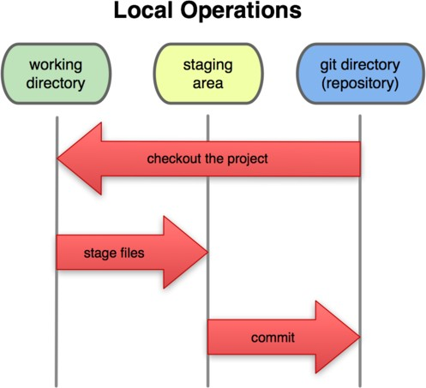
Local git areas
In our local copy on git, files can be:
In our local repo
(committed)
Checked out and modified, but not yet committed
(working copy)
Or, in-between, in a "staging" area
Staged files are ready to be committed.
Unmodified/modified Files
Staged Files
Committed Files
A commit saves a snapshot of all staged state.

Slide 7
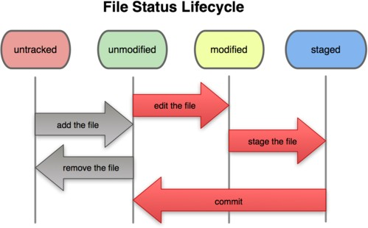
Basic Git workflow
Modify files in our working directory.
Stage files, adding snapshots of them to our staging area.
Commit, which takes the files in the staging area and stores that snapshot permanently to our Git directory.

Slide 8
Git commit checksums
In Subversion each modification to the central repo increments the version # of the overall repo.
In Git, each user has their own copy of the repo, and commits changes to their local copy of the repo before pushing to the central server.
So Git generates a unique SHA-1 hash (40 character string of hex digits) for every commit.
Refers to commits by this ID rather than a version number.
Often we only see the first 7 characters:
1677b2d Edited first line of readme
258efa7 Added line to readme
0e52da7 Initial commit

Slide 9
Initial Git configuration
Set the name and email for Git to use when we commit:
git config --global user.name "Bugs Bunny"
git config --global user.email bugs@gmail.com
– We can call git config –list to verify these are set.
Set the editor that is used for writing commit messages:
git config --global core.editor nano
(it is vim by default)

Slide 10
Creating a Git repo
Two common scenarios: (only one of these is done)
To create a new local Git repo in our current directory:
git init
This will create a .git directory in our current directory.
Then we can commit files in that directory into the repo.
git add filename
git commit –m "commit message"
To clone a remote repo to our current directory:
git clone url localDirectoryName
This will create the given local directory, containing a working copy of the files from the repo, and a .git directory (used to hold the staging area and our actual local repo)

Slide 11
Git commands
command | description
git clone url [dir] | copy a Git repository so we can add to it
git add file | adds file contents to the staging area
git commit | records a snapshot of the staging area
git status | view the status of our files in the working directory and staging area
git diff | shows diff of what is staged and what is modified but unstaged
git help [command] | get help info about a particular command
git pull | fetch from a remote repo and try to merge into the current branch
git push | push our new branches and data to a remote repository
others: init, reset, branch, checkout, merge, log, tag

Slide 12
Add and commit a file
The first time we ask a file to be tracked, and every time before we commit a file, we must add it to the staging area:
git add Hello.java Goodbye.java
Takes a snapshot of these files, adds them to the staging area.
In older VCS, "add" means "start tracking this file." In Git, "add" means "add to staging area" so it will be part of the next commit.
To move staged changes into the repo, we commit:
git commit –m "Fixing bug #22"
To undo changes on a file before we have committed it:
git reset HEAD -- filename
git checkout -- filename
(unstages the file) (undoes our changes)
– All these commands are acting on our local version of repo.

Slide 13
Viewing/undoing changes
To view status of files in working directory and staging area:
git status or git status –s (short version)
To see what is modified but unstaged:
git diff
To see a list of staged changes:
git diff --cached
To see a log of all changes in our local repo:
git log or git log --oneline (shorter version)
1677b2d Edited first line of readme 258efa7 Added line to readme 0e52da7 Initial commit
git log -n (to show only the n most recent updates), etc.

Slide 14
An example workflow
[rea@attu1 superstar]$ emacs rea.txt
[rea@attu1 superstar]$ git status
no changes added to commit
(use "git add" and/or "git commit -a")
[rea@attu1 superstar]$ git status -s
M rea.txt
[rea@attu1 superstar]$ git diff
diff --git a/rea.txt b/rea.txt [rea@attu1 superstar]$ git add rea.txt [rea@attu1 superstar]$ git status
# modified: rea.txt
[rea@attu1 superstar]$ git diff --cached
diff --git a/rea.txt b/rea.txt
[rea@attu1 superstar]$ git commit -m "Created new text file"

Slide 15
Branching and merging
Git uses branching heavily to switch between multiple tasks.
To create a new local branch:
git branch name
To list all local branches: (* = current branch)
git branch
To switch to a given local branch:
git checkout branchname
To merge changes from a branch into the local master:
git checkout master
git merge branchname

Slide 16
Merge conflicts
The conflicting file will contain <<< and >>> sections to indicate where Git was unable to resolve a conflict:
<<<<<<< HEAD:index.html
<div id="footer">todo: message here</div>
=======
<div id="footer">
thanks for visiting our site
</div>
>>>>>>> SpecialBranch:index.html
branch 1's version
branch 2's version
Find all such sections, and edit them to the proper state (whichever of the two versions is newer / better / more correct).

Slide 17
Interaction w/ remote repo
Push local changes to the remote repo.
Pull from remote repo to get most recent changes.
– (fix conflicts if necessary, add/commit them to our local repo)
To fetch the most recent updates from the remote repo into our local repo, and put them into our working directory:
git pull origin master
To put our changes from our local repo in the remote repo:
git push origin master

Slide 18
GitHub
GitHub.com is a site for online storage of Git repositories.
We can create a remote repo there and push code to it.
Many open source projects use it, such as the Linux kernel.
We can get free space for open source projects, or can pay for private projects.
Free private repos for educational use: github.com/edu
Question: Do we always have to use GitHub like online storages to use Git?
Answer: No! We can use Git locally for our own purposes.
Or we or someone else could set up a server to share files.
Or we could share a repo with users on the same file system, as long everyone has the needed file permissions).

Slide 19
References
https://git-scm.com/
https://en.wikipedia.org/wiki/Git
"Initial revision of "git", the information manager from hell". Github. 8 April 2005
"Tech Talk: Linus Torvalds on git (at 00:01:30)". YouTube. Archived from the original on 20 December 2015. Retrieved 20 July 2014
Linus Torvalds (3 May 2007). Google tech talk: Linus Torvalds on git. Event occurs at 02:30. Archived from the original on 28 May 2007. Retrieved 16 May 2007.
"A Short History of Git". Pro Git (2nd ed.). Apress. 2014. Archived from the original on 25 December 2015. Retrieved 26 December 2015

